Slide 1
Maharana Pratap: The Undying Symbol of Rajput Resistance
A Presentation on Maharana Pratap

Slide 2
Overview: A Glimpse into the Life and Legacy of Maharana Pratap
We will explore Maharana Pratap's birth, family, and ascension to the throne of Mewar.
His unwavering defiance against the Mughal Empire will be examined in detail.
Key battles and strategic decisions that shaped his reign will be discussed.
His enduring legacy as a symbol of courage and resistance will be highlighted.
We will address common misconceptions surrounding his life and legend.

Slide 3
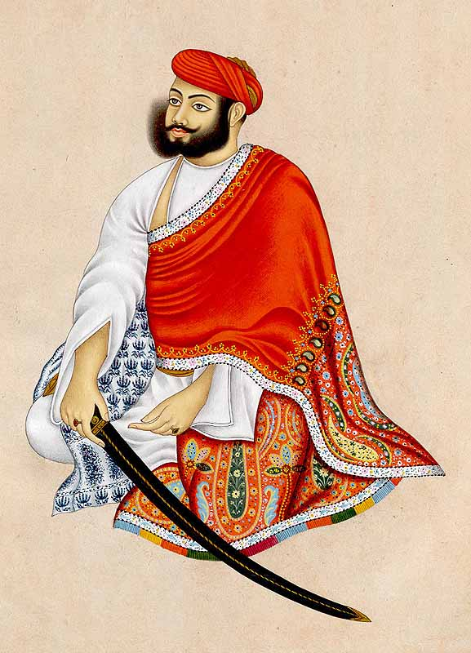
Early Life and Accession to the Throne
Born in 1540 to Udai Singh II and Jaiwanta Bai, Pratap was not initially the heir apparent.
He ascended to the throne of Mewar in 1572 after his father's death.
His brothers, Shakti Singh, Vikram Singh, and Jagmal Singh, played significant roles in Mewar's political landscape.
His chief consort, Ajabde Bai Punwar, was a significant figure in supporting him.

Slide 4
The Battle Against Akbar and the Mughal Empire
Maharana Pratap's refusal to submit to Mughal emperor Akbar defined his reign.
The Battle of Haldighati, though tactically a Mughal victory, showcased Pratap's unmatched bravery and strategic resilience.
He continued his resistance for the remainder of his life, leading a guerilla warfare campaign.
His unwavering commitment to his people and ideals kept the spirit of Mewar alive.

Slide 5
Governance and Legacy
Maharana Pratap ruled Mewar for 25 years, focusing on maintaining his kingdom's independence.
He shifted his capital to Chavand, effectively evading Mughal control.
His administrative policies aimed at strengthening his kingdom's resilience.
He is remembered as a symbol of Rajput valor, Hindu resistance, and unwavering patriotism.

Slide 6

Enduring Symbol and Misconceptions
Maharana Pratap remains a powerful symbol of resistance and courage in Indian history.
His image is frequently used in Indian politics and popular culture.
While exaggerated tales exist, his true legacy lies in his steadfast defiance and leadership.
Unreliable sources often fabricate details about his life, including his height.

Slide 7
Conclusion: The Unwavering Spirit of Maharana Pratap
Maharana Pratap's life stands as a testament to courage, perseverance, and the fight for independence.
His legacy continues to inspire generations to stand up against oppression.
His story serves as a reminder of the importance of fighting for one's beliefs and protecting one's heritage.
The study of his life offers valuable lessons in leadership, strategy, and the enduring human spirit.

